Slide 1
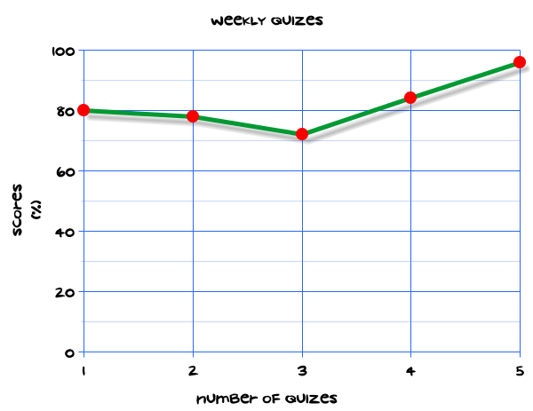
My Statistics Interactive Notebook
Name
Class
Teacher
Term 1 Semester 1
1

Slide 2
Create your own front page
It needs to contain the following –
My number interactive notebook
Name
Class
Teachers Name
Semester 1 Term 1
Page number 1

Slide 3
Contents
Glossary or Formula Page
Page
Date
Description
2
3

Slide 4
Tasks
24
7
30
Essential Question
Questions
Notes
Summary
4
5

Slide 5
24
7
30
Date
Title
EQ –
5

Slide 6
24
7
30
Date
Measures of Centre
EQ – Describe the differences between the different types of averages.
5

Slide 7
Task
1. These scores were achieved by students from two classes on a test.
Form 7X:
13, 27, 32, 29, 7, 23, 25, 38, 19, 33, 18, 19, 19, 13, 14, 4, 39, 40, 12, 28, 7, 24
Form 7Y:
31, 7, 20, 13, 20, 39, 18, 15, 8, 15, 15, 19, 17, 25, 8, 17, 13, 23, 12, 22, 31, 8, 29
Set up a back to back stem and leaf plot to compare the class performances.
2. A group of plants were measured and their heights recorded.
12.50 6.30 9.80 5.20 12.03 2.01 5.69 9.25 8.95 12.30 14.60 15.20 8.20 9.08 4.12 7.89 11.30 7.89 2.56 10.30 4.90 2.90 2.36 2.01 4.99 2.36 9.06 12.30 0.30 10.10
Set up a tally table with intervals of 2 cm.
Construct a histogram of the information.

Slide 8
Questions

Slide 9
Notes Review
24, 7 ,30
Date
Title
Essential question
Notes complete
Notes complete with colour and diagrams
Questions completed
Contents page filled in
Formula page filled in

Slide 10
Homework
Review your notes and write a summary answering the essential question.

